Slide 1

HI6050 Capstone: Comprehensive Topic Selection and Supplementary Document
Supervisor: Dr. Farshid Keivanian
Session 5: Preparation for Group Final Report: Project Build & Final Report Writing Plan: Project Build & Final Report Writing Plan

Slide 2
Session 5’s outline
1. Weekly Task Breakdown & Milestones
2. Preparation for Group Final Report: Project Build & Final Report Writing Plan: Project Build & Final Report Writing Plan
3. Group Progress Presentation – Overview of Progress at least 2 min

Slide 3
Weekly Task Breakdown & Milestones
Week | Action
Week 1-2 | Form groups, confirm your campus group number, select topic via Blackboard sheet.
Week 3 | Begin literature review + define project scope and research question.
Week 4 | Finalize tools, datasets, programming language; create basic prototypes/mockups.
Week 5 | Draft your research proposal + submit it.
Week 6 | Submit Research Proposal (25%)
Week 7-10 | Start project build (coding/analysis), write sections of final report.
Week 11 | Submit Final Report (45%)
Week 12 | Present & Demo Project (30%)

Slide 4
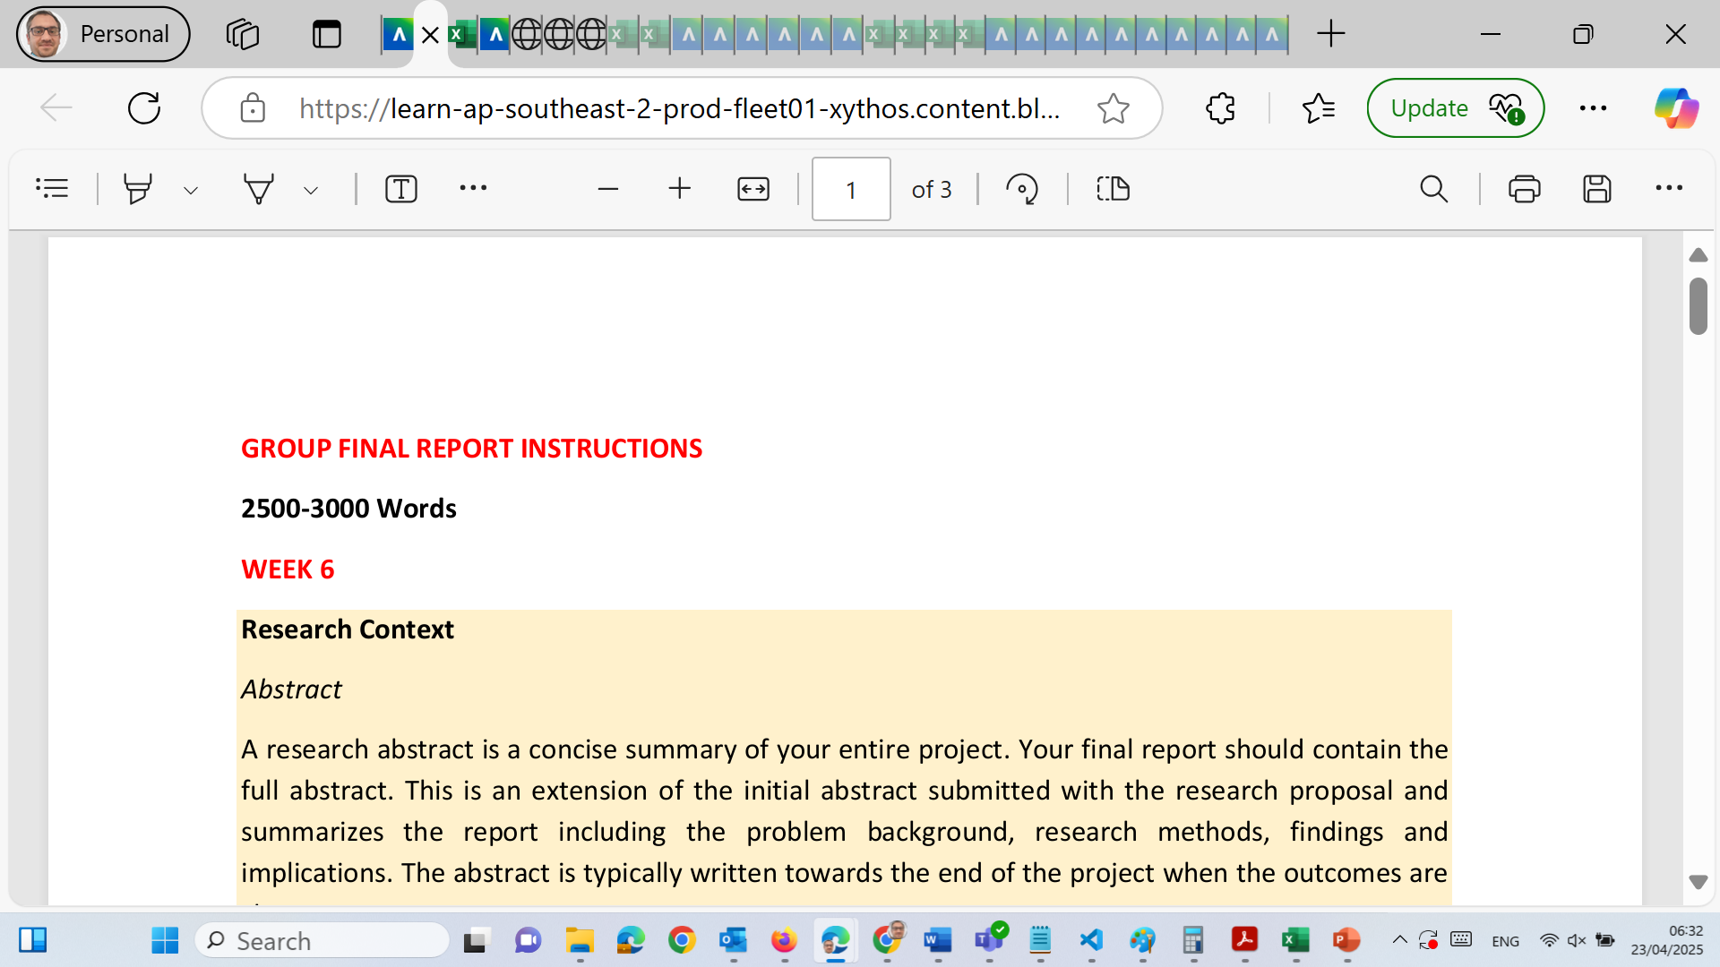
Preparation for Group Final Report: Project Build & Final Report Writing Plan

Slide 5
Preparation for Group Final Report: Project Build & Final Report Writing Plan
Project Build + Report Drafting (Independent Work + Weekly Check-ins)
Goals:
Begin technical work (e.g., coding, modeling, dashboarding)
Write the main report sections: Introduction, Methodology, Literature Review, Results, Discussion

Slide 6
Preparation for Group Final Report: Project Build & Final Report Writing Plan
What to Do:
Allocate roles: coder, document writer, reviewer
Use Agile-style standups (15 mins): what did we do, what’s next?
Use GitHub/Google Drive for collaboration

Slide 7
Preparation for Group Final Report: Project Build & Final Report Writing Plan
❌ What to Avoid:
Ignoring version control for report/code
Working last minute on results or analysis
Skipping documentation during development

Slide 8
Preparation for Group Final Report: Project Build & Final Report Writing Plan
Tips:
Start the report early – one section/week
Backup files regularly
Document failed attempts and what was learned

Slide 9
Preparation for Group Final Report: Project Build & Final Report Writing Plan
Example Guidance Based on Topics
Topic Example | Key Focus in Wk 3 | Tools in Wk 4 | Output by Wk 5
AI in Healthcare | Review use cases, challenges | Python, Scikit-learn, PubMed | Research Q: How effective is AI in early disease prediction?
Data Privacy Laws | Review global frameworks | Data scraping, legal archives | Research Q: How GDPR impacts corporate analytics?
Cybersecurity in E-commerce | Analyze breach cases | OWASP, PHP, MySQL | Research Q: What methods mitigate SQL injection attacks?
Data Analytics in Finance | Review fraud detection models | Python, Power BI | Research Q: Can ML detect real-time transaction fraud?

Slide 10
Preparation for Group Final Report: Project Build & Final Report Writing Plan
Resources to Provide Students
Literature Review Matrix Template (Excel)
Holmes Harvard Referencing Guide
Sample Proposal (Word)
Gantt Chart Template (Excel or PowerPoint)
Sample Abstracts and Research Questions
Session Slides (if you'd like, I can draft these)

Slide 11
Preparation for Group Final Report: Project Build & Final Report Writing Plan
Resources to Provide Students
Literature Review Matrix Template (Excel)
Holmes Harvard Referencing Guide
Sample Proposal (Word)
Gantt Chart Template (Excel or PowerPoint)
Sample Abstracts and Research Questions
Session Slides (if you'd like, I can draft these)

Slide 12
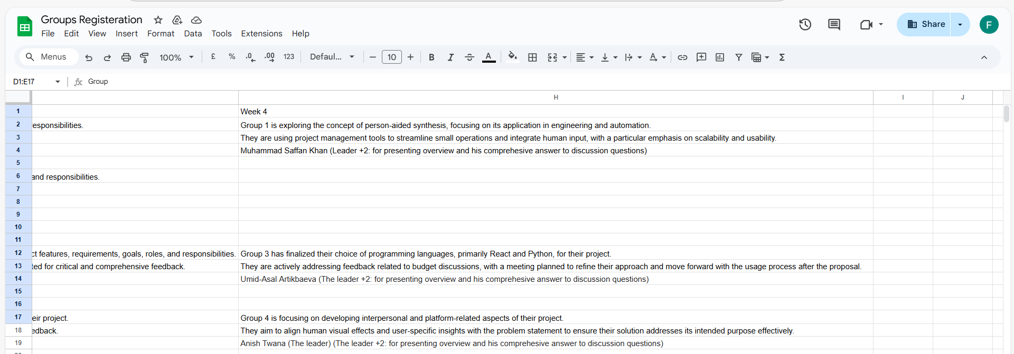
Group Progress Presentation – Overview of Progress at least 2 min

Slide 13
Thank You
Need Help? Send an email or ask during the tutorial session.
Good luck with your capstone journey!
Dr. Farshid Keivanian Capstone Project Supervisor farshid.keivanian@holmes.edu.au

